Slide 1

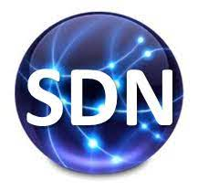
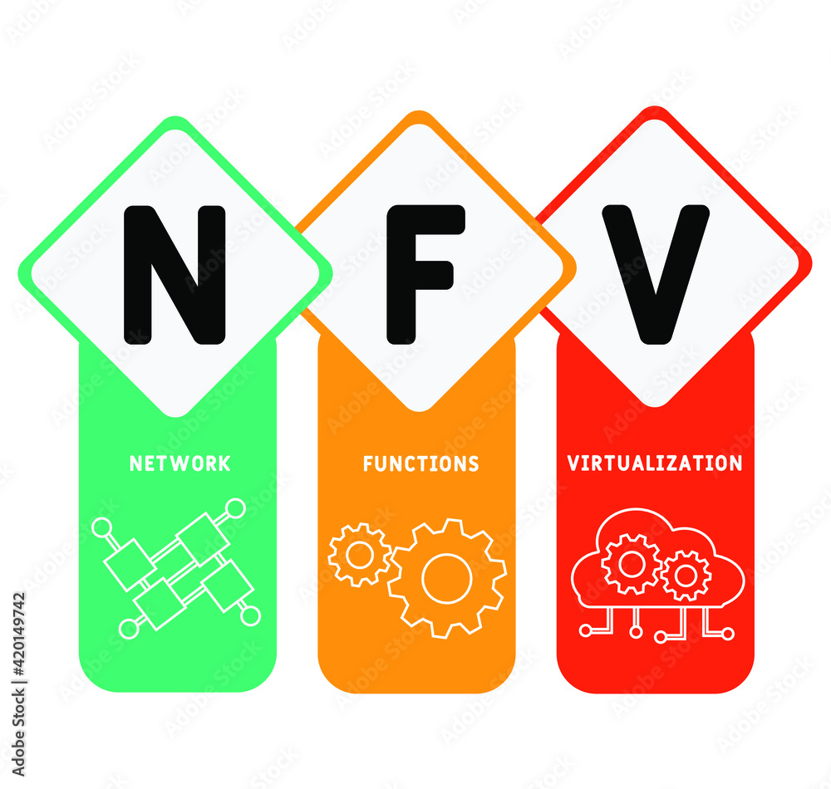

Create a Docker on Ubuntu 20.04 Docker Simple-apps
PDS
Computer Vision
Docker and Kubernetes
https://github.com/siagianp
https://www.youtube.com/@AmelOline/videos
https://github.com/amelcharolinesgn2/IoT_simulator-mqtt-NodeRed
https://github.com/amelcharolinesgn2/Cloud-Infrastructures
https://github.com/amelcharolinesgn2/ClouD-Infrastructure-SISKA-2025
https://github.com/amelcharolinesgn2/IoT_app-and-Modules
Notes:
https://www.idn.id/docker-pada-ubuntu-20-04/
https://medium.com/redbubble/running-a-docker-container-as-a-non-root-user-7d2e00f8ee15
https://www.digitalocean.com/community/tutorials/how-to-install-and-use-docker-compose-on-ubuntu-20-04

Slide 2
Docker and Kubernetes
Docker and Kubernetes (Cons’t)
Notes:
https://fernandocejas.com/blog/engineering/2023-01-06-over-engineered-home-lab-docker-kubernetes/

Slide 3
Docker and Kubernetes (Cons’t)
Main Software Stack Permalink:
Kubernetes: for managing containerized workloads and services.
Docker: for managing containerized applications.
Linux.
Arch: with LTS Kernel (for stability) as the main OS for the Servers.
OpenWRT: for network handling (DNS, Port Forwarding, DHCP, etc) inside my router.
Wireguad: for the encrypted virtual private network (VPN).
Kubernetes: The Main Components:
Cluster: When we deploy Kubernetes, we get a cluster.
Node: A node is a working machine in Kubernetes.
Pod: A Pod represents a set of running containers in our cluster.
Control Plane: The container orchestration layer that exposes the API and interfaces to define, deploy and manage the lifecycle of containers.
Notes:
https://fernandocejas.com/blog/engineering/2023-01-06-over-engineered-home-lab-docker-kubernetes/

Slide 4
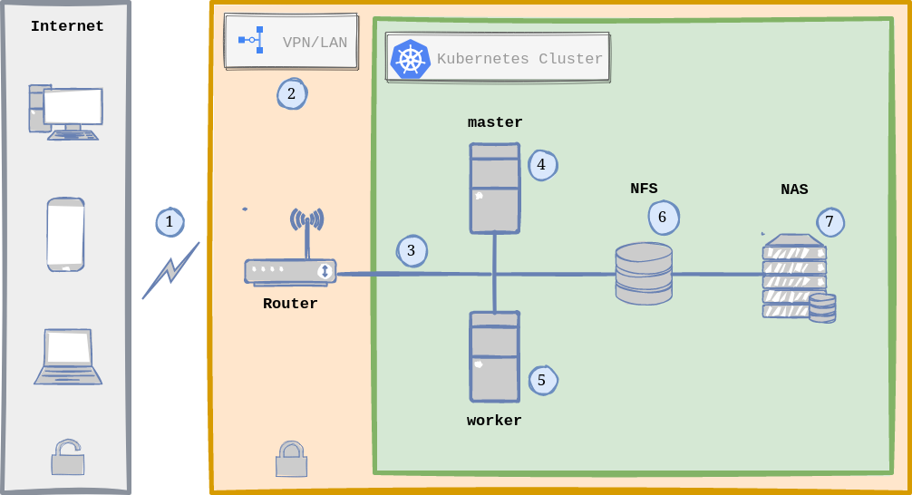
Docker and Kubernetes (Cons’t)
Kubernetes Arch:
Infrastructure with Kubernetes (k3s):
Traffic comming from the Internet (via Dynamic DNS) is received by the Router.
The router runs OpenWRT as OS and hosts and manages the VPN using Wireguard (more on this in the Security Section).
Once the request passes the security checks of the VPN, we are inside our Local Area Network (LAN), zone of Linux Servers and for instance, the Kubernetes Cluster.
The Kubernetes Cluster is composed by 2 Nodes running Linux: one node being the master (Kubernetes Control Plane) and the other is a worker.
In Reality both Kubernetes Nodes can act as workers, meaning that the load is distributed between both nodes via Ingress (usually NGINX), which acts as a Load Balancer and Reverse Proxy.
Persistence is handled by NFS (Network File System), which means that there is only one single point where I store my data/information.
The NAS (Network Attached Storage) contains some services specific to it (from Synology) and acts as a drive (via NFS) that both Linux Servers see as a local drive.
Notes:
https://fernandocejas.com/blog/engineering/2023-01-06-over-engineered-home-lab-docker-kubernetes/

Slide 5
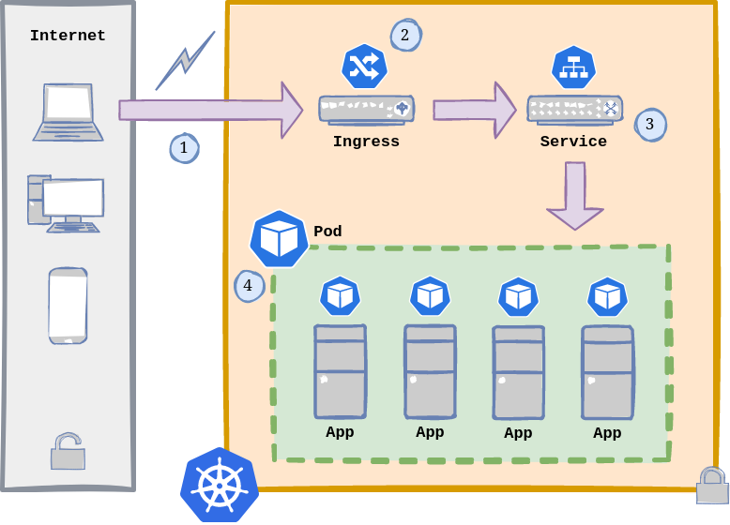
Docker and Kubernetes (Cons’t)
Kubernetes : Application Flow
Hosted app contained in the Kubernetes Cluster?
The flow:
A request enters our Kubernetes cluster from the outside (either from the Internet or LAN).
As mentioned before, an Ingress has these main functions:
a. Load Balancer: when it is declared as Service.Type=LoadBalancer.
b. Reverse Proxy: exposes HTTP and HTTPS routes from outside the cluster to
services within the cluster.
A Service is a method for exposing a network application that is running as one or more Pods in our cluster (if we skip setting up a service, we are not gonna be able to reach our containerized apps).
Pods are the smallest deployable units of computing that we can create and manage. Each of them is a group of one or more containers, with shared storage and network resources, and a specification for how to run the containers.
Notes:
https://fernandocejas.com/blog/engineering/2023-01-06-over-engineered-home-lab-docker-kubernetes/

Slide 6
Docker and Kubernetes (Cons’t)
Kubernetes : Cluster
Setup :
1. Install k3s MASTER and WORKER nodes.
2. Install kubectl (if not already installed after Step 1) in order to connect remotely to the cluster.
3. Install Helm if necessary, a package manager for Kubernetes, which will facilitate actually installing packages in our cluster.
4. Setup a Load Balancer. k3s already comes with ServiceLB, but I found MetalLB the right option for bare metal, because it makes the setup easier on clusters that are not running on cloud providers (we have to disable ServiceLB though){: target=”_blank” }.
5. Install Nginx Web/Reverse Proxy, which is our Ingress, in order to expose HTTP and HTTPS routes from outside the cluster to services within the cluster. k3s recommends another option too: Traefik, so up to you.
6. Install and configure cert-manager. I would label this as OPTIONAL but I guess we want to be able to have valid SSL/TSL Certificates to avoid our browser warning us when accessing our hosted applications.
7. Deploy and configure Kubernetes Dashboard, which is a web-based Kubernetes user interface.
A LINUX SERVER up and running (if it is just for testing, we could also use a couple of VMs).
SSH (or alternative/){: target=”_blank” }) properly configure in our headless server in order to manage it.
OPTIONAL: NFS up and running in our server, in case we want to store our data/information in an external network drive outside of our Linux Server.
root@administrator:/home/panda/GPU2#
$ kubectl get nodes -o wide
NAME STATUS ROLES AGE VERSION INTERNAL-IP EXTERNAL-IP
kube-master Ready master 44h v1.25.0+k3s.1 192.168.0.22 <none>
kube-worker Ready <none> 2m47s v1.25.0+k3s.1 192.168.0.23 <none>
Notes:
https://fernandocejas.com/blog/engineering/2023-01-06-over-engineered-home-lab-docker-kubernetes/

Slide 7
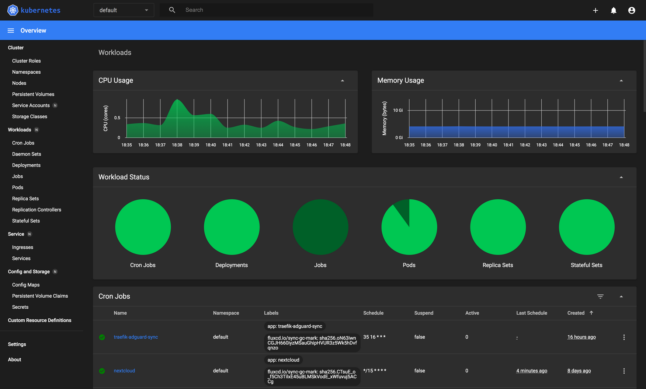
Docker and Kubernetes (Cons’t)
Kubernetes Dasboard
Notes:
https://fernandocejas.com/blog/engineering/2023-01-06-over-engineered-home-lab-docker-kubernetes/

Slide 8
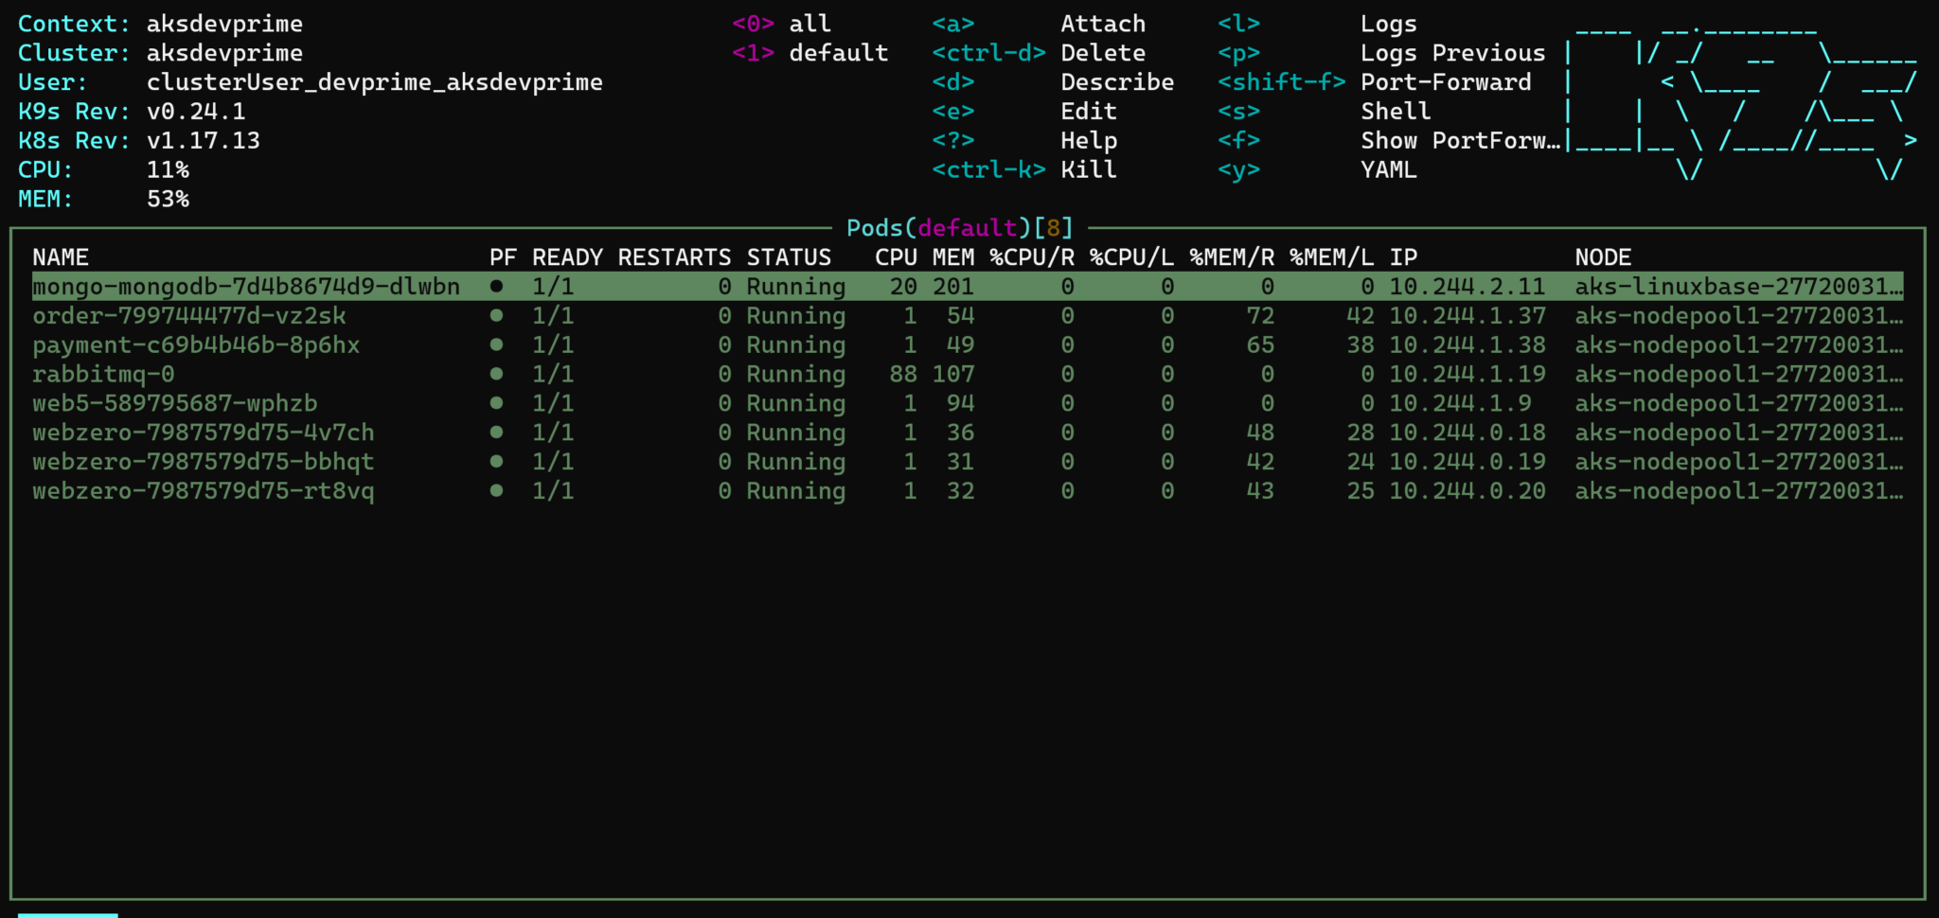
Docker and Kubernetes (Cons’t)
Kubernetes : Administration
We have a variety of tools in this area:
kubectl (already installed).
Kubernetes Dashboard (already installed).
Lens
Kuvenav
k9s
Notes:
https://fernandocejas.com/blog/engineering/2023-01-06-over-engineered-home-lab-docker-kubernetes/

Slide 9
Docker and Kubernetes (Cons’t)
apiVersion: apps/v1
kind: Deployment
metadata:
namespace: home-cloud-drawio
name: drawio
spec:
replicas: 1
selector:
matchLabels:
app: drawio
template:
metadata:
labels:
app: drawio
spec:
containers:
- name: drawio
image: jgraph/drawio
resources:
limits:
memory: "256Mi"
cpu: "800m"
ports:
- containerPort: 8080
---
apiVersion: v1
kind: Service
metadata:
namespace: home-cloud-drawio
name: drawio-service
spec:
selector:
app: drawio
ports:
- port: 5001
targetPort: 8080
---
apiVersion: networking.k8s.io/v1
kind: Ingress
metadata:
namespace: home-cloud-drawio
name: drawio-ingress
labels:
name: drawio-ingress
spec:
rules:
- host: home-cloud-drawio
http:
paths:
- pathType: Prefix
path: "/"
backend:
service:
name: drawio-service
port:
number: 5001
ingressClassName: "nginx"
Kubernetes : Application Example
This is a simple example where we will be deploying https://draw.io/ to our Kubernetes cluster.
First, we create a namespace for our draw.io application called home-cloud-drawio :
$ kubectl create namespace home-cloud-drawio
Second, we create a file called drawio-app.yml with the following content:
root@administrator:/home/panda/GPU2#
$ kubectl create namespace home-cloud-drawio
Notes:
https://fernandocejas.com/blog/engineering/2023-01-06-over-engineered-home-lab-docker-kubernetes/

Slide 10
Docker and Kubernetes (Cons’t)
Kubernetes : Application Example
root@administrator:/home/panda/GPU2#
kubectl get services -o wide --all-namespaces
NAMESPACE NAME TYPE CLUSTER-IP EXTERNAL-IP
default kubernetes ClusterIP 10.43.0.1 <none>
kube-system kube-dns ClusterIP 10.43.0.10 <none>
kube-system metrics-server ClusterIP 10.43.33.97 <none>
kube-system nginx-ingress LoadBalancer 10.43.196.229 192.168.0.200
Home-cloud-drawio drawio ClusterIP 10.43.35.88 <none>
As a third step, we apply the configuration contained in the drawio-app.yml file::
$ kubectl apply –f drawio-app.yml
root@administrator:/home/panda/GPU2#
$ kubectl apply –f drawio-app.yml
OK_Goes!!! We have basically created a Deployment, which includes a Service and Ingress configuration to access our hosted app from outside the cluster.
Now let’s check the running services to corroborate that everything works as expected:
Notes:
https://fernandocejas.com/blog/engineering/2023-01-06-over-engineered-home-lab-docker-kubernetes/

Slide 11
Docker and Kubernetes (Cons’t)
Kubernetes: Useful Commands
# Cluster information
$ kubectl cluster-info
$ kubectl get nodes -o wide
# Check runnint Services
$ kubectl get services -o wide --all-namespaces
# Check running Ingress
$ kubectl get ingresses --all-namespaces
# Display all the running Pod
$ kubectl get pods -A -o wide
# Get logs for an specific Pod
$ kubectl logs -f <your_pod> -n <your_pod_namespace>
# Get information about an specific Pod
$ kubectl describe pod <your_pod> -n <your_pod_namespace
Notes:
https://fernandocejas.com/blog/engineering/2023-01-06-over-engineered-home-lab-docker-kubernetes/

Slide 12
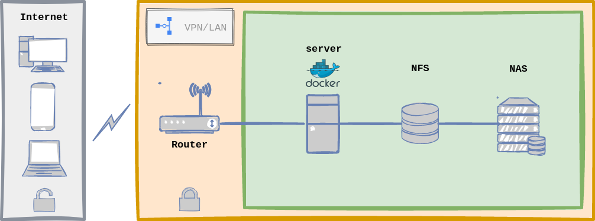
Docker and Kubernetes (Cons’t)
A simpler Docker Approach
Notes:
https://fernandocejas.com/blog/engineering/2023-01-06-over-engineered-home-lab-docker-kubernetes/

Slide 13
Docker and Kubernetes (Cons’t)
Upfront, this infrastructure architecture seems very similar to the one defined with Kubernetes, and indeed it is, the flow is the same as described above and server configuration is equal too. The biggest changeset has to do with implementation details:
I only need one server (load distribution is off here).
Handling configuration files with docker is easier.
Less moving parts, les complexity, for instance, less to maintain.
I do not need a system for Microservices Orchestration.
As an example, we will setup the same application as above: draw.io with docker compose:
We add this content to our docker compose file called home-lab.yml:
version: "3.8"
services:
traefik:
image: traefik:latest
container_name: traefik
command:
# Dynamic Configuration: mostly used for TSL certificates
- --providers.file.filename=/etc/traefik/dynamic_conf.yml
# Entrypoints configuration
- --entrypoints.web-secure.address=:443
labels:
- traefik.http.routers.traefik_route.rule=Host(`traefik.home.lab`)
- traefik.http.routers.traefik_route.tls=true
- traefik.http.routers.traefik_route.service=traefik_service
- traefik.http.services.traefik_service.loadbalancer.server.port=8080
ports:
- 80:80
- 443:443
volumes:
- ~/traefik/dynamic_conf.yml:/etc/traefik/dynamic_conf.yml
- ~/traefik/_wildcard.home.lab.pem:/etc/traefik/_wildcard.home.lab.pem
- ~/traefik/_wildcard.home.lab-key.pem:/etc/traefik/_wildcard.home.lab-key.pem
networks:
- home-lab-network
restart: always
drawio:
image: jgraph/drawio:latest
container_name: drawio
labels:
- traefik.http.routers.drawio_route.rule=Host(`drawio.home.lab`)
- traefik.http.routers.drawio_route.tls=true
- traefik.http.routers.drawio_route.service=drawio_service
- traefik.http.services.drawio_service.loadbalancer.server.port=8080
networks:
- home-lab-network
restart: always
Notes:
https://fernandocejas.com/blog/engineering/2023-01-06-over-engineered-home-lab-docker-kubernetes/
https://fernandocejas.com/blog/engineering/2023-01-06-over-engineered-home-lab-docker-kubernetes/

Slide 14
Docker Simple-apps

Slide 15
Docker
Komponen utama :
Images
Container
Dockerfile
Docker Compose
Docker Hub
Notes:
https://www.idn.id/docker-pada-ubuntu-20-04/
https://www.domainesia.com/tips/cara-install-docker-di-ubuntu/
https://www.hostinger.com/tutorials/how-to-install-docker-on-ubuntu

Slide 16
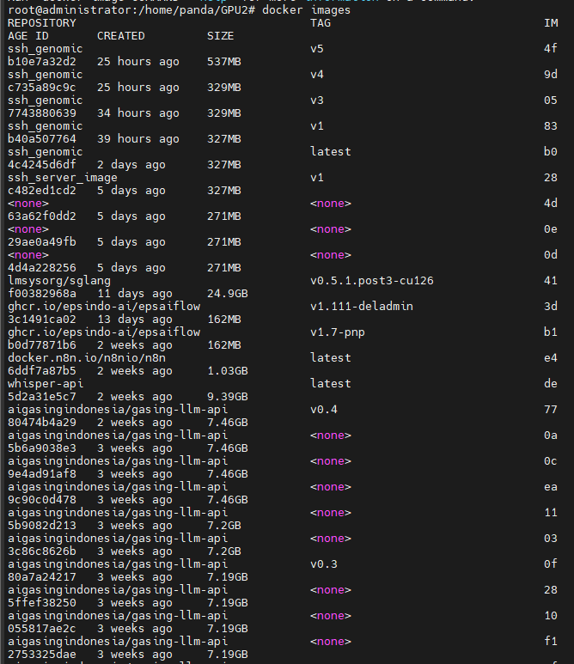
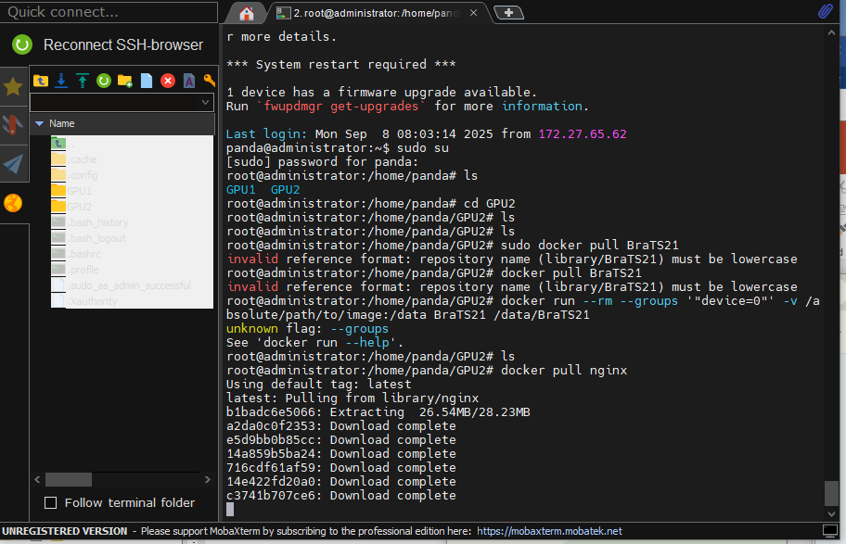
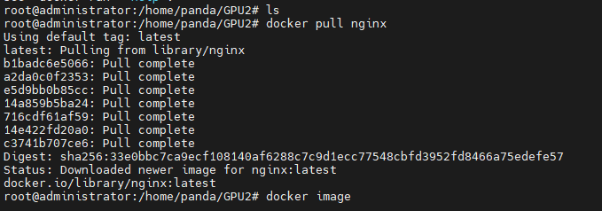
Image
Docker
docker pull <nama images>Untuk mengambil atau pull images dari registry docker. Untuk melihat hasil image yang dipull kalian dapat menggunakan perintah docker images.
docker pull <nama images>Untuk mengambil atau pull images dari registry docker. Untuk melihat hasil image yang dipull kalian dapat menggunakan perintah docker images.
root@administrator:/home/panda/GPU2# docker pull nginx
root@administrator:/home/panda/GPU2# docker images

Slide 17
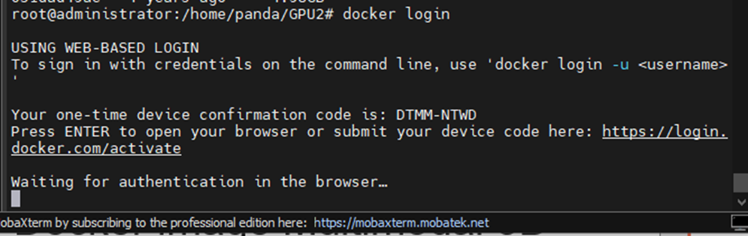
Image
Docker
docker push <nama image> Untuk mengunggah image yang telah dibuat ke registriy lokal maupun global, tergantung kebutuhan. Untuk melakukan push ke docker hub, pastikan kalian sudah membuat tag untuk image dan login menggunakan akun docker hub terlebih dahulu. Gunakan perintah docker tag dan docker login.//pastikan login menggunakan akun docker hub kalian #docker login
#docker tag <nama image asli:tag> <image yang ditag:tag> //dalam membuat tag pastikan kalian juga menggunakan format usernamedockerhub/namaimage
root@administrator:/home/panda/GPU2# docker tag nginx Amel/web-1
root@administrator:/home/panda/GPU2# docker images
Repostory TAG IMAGE ID CREATED SIZE
Nginx latest f5awhshswya2 2 days ago 187MB
Amel/web-1 latest f5awhshswya2 2 days ago 187MB
registry 2 0030ba3d760c 2 weeks ago 24.1MB
root@administrator:/home/panda/GPU2# docker login
Username: amel
Password:
Login Succeeded
root@administrator:/home/panda/GPU2#

Slide 18
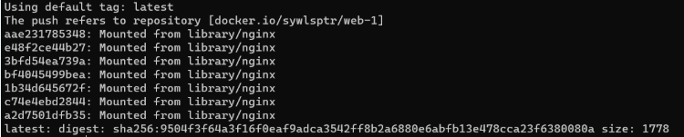
Image
Docker
docker run <options> <nama image>Untuk menjalankan container menggunakan images yang ada. Untuk opsi yang digunakan beragam. Untuk melihat container yang sedang berjalan kalian dapat menggunakan perintah docker ps. Nanti akan terlihat status dari container.#docker run -d -p 80:80 --name web-1 nginx penjelasan opsi perintah: -d --> agar container dapat berjalan dilatar belakang -p --> untuk expose port dari container. --name --> untuk menentukan nama container yang akan dideploy
#docker push <nama image>
root@administrator:/home/panda/GPU2# docker push Amel/web-1
root@administrator:/home/panda/GPU2# docker push Amel/web-1
Using default tag: latest
The push refers to repository [docker.io/Amel/web-1]
root@administrator:/home/panda/GPU2#
root@administrator:/home/panda/GPU2# docker run –d –p 80:80 –name web-1 nginx
root@administrator:/home/panda/GPU2# docker run –d –p 80:80 –name web-1 nginx
1819991882ggfrqy11yy1yu1uuuuuuuuuuuuu1uuuu0c
root@administrator:/home/panda/GPU2# docker ps
root@administrator:/home/panda/GPU2#

Slide 19
Image
Docker
docker start <nama atau id container>Untuk menjalankan container yang sedang tidak aktif atau tidak berjalan. Jika berhasil kalain dapat lihat containernya sudah status Up kembali.
docker stop <nama atau id container>Untuk menghentikan atau stop container yang sedang aktif atau berjalan. Untuk melihat container docker yang statusnya tidak jalan dapat menggunakan perintah docker ps -a. Jika status dari container sudah Exited, berarti container sudah dalam keadaan down.
root@administrator:/home/panda/GPU2# docker start web-1
root@administrator:/home/panda/GPU2# docker stop web-1
root@administrator:/home/panda/GPU2# docker stop web-1
Web-1
root@administrator:/home/panda/GPU2# docker -a
root@administrator:/home/panda/GPU2#
root@administrator:/home/panda/GPU2# docker stop web-1
Web-1
root@administrator:/home/panda/GPU2# docker -a
root@administrator:/home/panda/GPU2#
Notes:
https://www.idn.id/docker-pada-ubuntu-20-04/

Slide 20
Image
Docker
docker exec <options> <nama container> <perintah>Untuk masuk ke terminal dari container yang sudah berjalan.#docker exec -it web-1 /bin/bash //Disini saya uji coba masuk ke container web-1 dan masuk dengan privileged /bin/bash. //Untuk keluar dari terminal container kalian cukup ketikan perintah #exit
docker rename <nama container lama> <nama container baru>Digunakan untuk merename nama container. Disini kita akan mencoba rename container web-1 menjadi web-2#docker rename web-1 web-2
root@administrator:/home/panda/GPU2# docker exec –it web-1 /bin/bash
root@ f5awhshswya2:/# ls
root@administrator:/home/panda/GPU2# docker exec –it web-1 /bin/bash
root@ f5awhshswya2:/# ls
root@administrator:/home/panda/GPU2# docker rename web-1 web-2
root@administrator:/home/panda/GPU2# docker ps
root@administrator:/home/panda/GPU2#
root@administrator:/home/panda/GPU2# docker exec –it web-1 /bin/bash
root@f5awhshswya2:/# ls
root@f5awhshswya2:/# ls
root@administrator:/home/panda/GPU2#

Slide 21
Image
Docker
Instalasi
Lakukan update pada server dan instal package docker.io.$sudo apt update -y && sudo apt install docker.io
Instal juga package virtual environment python3 untuk uji coba menjalankan aplikasi webnya.$sudo apt install python3.8-venv -y
p
Goal
Deploy simple app dengan flask
Isi file main.pyfrom flask import Flask from flask import request from flask import render_template sample = Flask( name ) @sample.route("/") def main(): return render_template("index.html") if name == " main ": sample.run(host="0.0.0.0", port=8080)
Isi file index.html<html> <head> <title>Sample app using Flask python</title> </head> <body> <h1>You are calling me from {{request.remote_addr}}</h1> </body> </html>
Deploy simple app tersebut ke dalam container

Slide 22
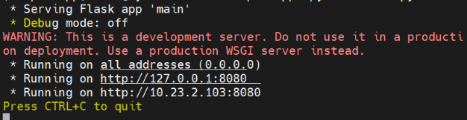
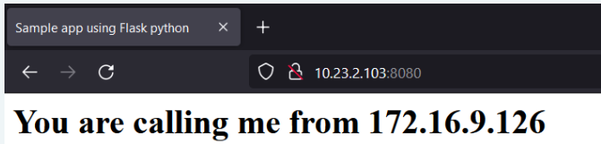
Image
Docker
Pengujian
Sekarang kita akan menguji coba, apakah simple app yang kita buat sudah berjalan.#python3 main.py
Jika hasil dari menjalankan perintah diatas seperti ini, maka simple app yang kita buat telah berjalan.
Sekarang kita buka web browser dan ketikkan alamat ip beserta port simple app yang kita buat. Jika berhasil maka hasilnya akan seperti gambar dibawah
Kalian juga dapat melihat log alamat IP apa saja yang mengakses simple app yang kita buat.
Konfigurasi Sample App
Pertama kita akan membuat folder untuk menyimpan file konfigurasi simple app yang akan kita buat.$sudo mkdir -p /flask/sample-app/templates
Masuk ke direktori yang sudah dibuat.$cd /flask/sample-app
Buatlah virtual environment python3 baru pada direktori tempat kita menyimpan konfigurasi simple app.$sudo python3 -m venv /flask/sample-app
Buatlah file main.py dan isikan sesuai dari ketentuan goals.$sudo vim main.py -----Isi File dengan ketentuan Goals----- from flask import Flask from flask import request from flask import render_template sample = Flask(__name__) @sample.route("/") def main(): return render_template("index.html") if __name__ == "__main__": sample.run(host="0.0.0.0", port=8080)
Buatlah file index.html dan isikan dengan source code sesuai dengan ketentuan.$sudo vim templates/index.html -----Isi File dengan ketentuan Goals---- <html> <head> <title>Sample app using Flask python</title> </head> <body> <h1>You are calling me from {{request.remote_addr}}</h1> </body> </html>
Masuk sebagai user sudo dan jalankan perintah untuk mengaktifkan virtual environment python yang tadinya telah dibuat.$sudo su #. bin/activate
Sekarang kita instal Flask menggunakan perintah pip.#pip3 install Flask
( sample-app ) root@panda: /flash/sample-app# python3 main.py
* Serving Flash app ‘main’
* Debug mode: off
root@administrator:/home/panda/GPU2#
Notes:
https://www.idn.id/docker-pada-ubuntu-20-04/

Slide 23
Image
Docker
FROM python:3.8-slimMengambil atau mengepull image python:3.8-slim dari docker hub
EXPOSE 80Untuk mendefinisikan port untuk container saat diaktifkan
RUN mkdir -p /flask/sample-appDigunakan untuk mengeksekusi perintah mkdir… pada saat pembuatan image.
WORKDIR /flask/sample-appPerintah ini digunakan untuk masuk ke Working Directory (direktori kerj)a yang akan digunakan. Sama seperti saat kita menggunakan perintah cd /flask/sample-app.
COPY requirements.txt .Digunakan untuk mengcopy file requirements.txt yang telah kita buat kedalam Working Directory.
COPY main.py .Digunakan untuk mengcopy file main.py yang telah kita buat kedalam Working Directory.
COPY templates/index.html templates/index.htmlDigunakan untuk mengcopy file index.html yang telah kita buat kedalam folder templates/.
RUN pip3 install -r requirements.txtDigunakan untuk mengeksekusi perintah pip3… yang dimana menginstal semua dependencies yang ada pada isi file requirements.txt.
CMD [“python3”, “main.py“]Digunakan untuk mengeksekusi perintah utama pada saat container berjalan.
Selanjutnya kita build docker images dengan perintah dibawah.#docker built -t <tag untuk nama images> <direktori letak Dockerfile> contoh: #docker built -t sampleapp .
Kemudian, jalankan docker container menggunakan images yang telah kita buat. Jangan lupa untuk expose portnya ke 80, agar nantinya kita tidak perlu lagi mengetikkan port saat uji coba diweb browser.#docker run -d -p 80:8080 --name sampleapp-flask sampleapp
Konfigurasi Docker
Setelah kita melakukan uji coba pada simple app kita, sekarang kita akan melakukan konfigurasi untuk menjalankan web kita pada docker container. Pertama buatlah file requirements.txt.#touch requirements.txt
Jalankan perintah pip3 freeze. Fungsinya disini untuk memasukkan semua requirements dependencies yang perlu di instal untuk menjalankan simple app yang kita buat (Fungsi file ini sama seperti file package.json pada NodeJS). File ini nanti berguna saat kita mendeploy simple app yang kita buat pada container.#pip3 freeze > requirements.txt
Keluar dari virtual environment dengan menggunakan perintah dibawah.#deactivate
Sekarang kita akan membuat Dockerfile. Dockerfile ini digunakan untuk membuat image sesuai dengan kebutuhan yang kita perlukan. Umumnya isi pada dockerfile merupakan langkah-langkah yang kita gunakan saat mencoba deploy simple app flask kita. Jika kalian perhatikan dengan baik, isi Dockerfile merupakan requirement-requirement saat kita mendeploy simple app flask.#vim Dockerfile ------Isi Docker File----- FROM python:3.8-slim EXPOSE 80 RUN mkdir -p /flask/sample-app WORKDIR /flask/sample-app COPY requirements.txt . COPY main.py . COPY templates/index.html templates/index.html RUN pip3 install -r requirements.txt CMD ["python3", "main.py"]Penjelasan beberapa perintah pada Dockerfile:

Slide 24
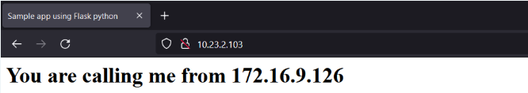
Image
Docker
Deploy Simple App NodeJS
Pada materi sebelumnya kita melakukan deploy pada server kita menggunakan Simple App NodeJS. Nah pada kesempatan ini saya akan membantu kalian dalam melakukan konfigurasi sederhana untuk mendeploy Simple App NodeJS kedalam docker. Seperti halnya pada pembuat simple app flask, kita akan membuat Dockerfile terlebih dahulu lalu menjalankannya. Selain itu kita akan coba juga untuk membuat Docker Compose. Untuk memahami lebih lanjut
Pengujian
Setelah container dijalankan, kita lihat status dari container sudah benar-benar jalan atau belum. Gunakan perintah dibawah untuk melihat status container.#docker container ls
Selanjutnya kita uji coba lagi dengan mengetikkan alamat IP server. Dapat dilihat pada hasil gambar dibawah, kita tidak perlu lagi mengetikkan port untuk membuka simple app yang kita buat.
root@panda: /flash/sample-app# docker container ls
root@administrator:/home/panda/GPU2#
Notes:
https://www.idn.id/docker-pada-ubuntu-20-04/

Slide 25

Image
Docker
Pengujian
Setelah membuat images dari Dockerfile, kita lihat apakah images yang sudah dibuat telah muncul atau belum dengan perintah docker images.#docker images
Jika images yang dibuat telah muncul, sekarang kita buat container dari images simple apps.#docker run -d -p 3000:3000 --name test-simple simple-apps
Kemudian kita lihat apakah container yang telah dibuat sudah jalan atau belum.#docker ps
Sekarang kita uji coba untuk dibuka dengan browser.
p
Konfigurasi Dockerfile
Masuk ke diretory tempat kalian menyimpan source code dari simple apps. Kemudian buatlah sebuah file baru dengan naman Dockerfile. Isikan Dockerfile dengan perintah dibawah. Dockerfile digunakan untuk membuat image baru berdasarkan konfigurasi yang diperlukan. Umumnya isi Dockerfile berupa requirements yang diperlukan dalam mendeploy apps kita. Pada sebelumnya kita menggunakan nodejs versi 16, namun disini saya ubah menggunakan nodejs versi 18.#cd /deploy/simple-apps --> direktori tempat saya menyimpan source code #vim Dockerfile ===isi file=== FROM node:18.16.0-slim WORKDIR /app ADD . . RUN npm install CMD npm start ===end===
Setelah Dockerfile dibuat, kita build image baru dari Dockerfile tersebut dengan perintah dibawah.#docker build -t simple-apps . //penjelasan -t --> untuk memberikan tag untuk image yang akan dibuat docker build -t <tag> <lokasi dockerfile berada>
p
root@panda: /deploy/simple-apps# docker images
root@panda: /deploy/simple-apps# docker ps

Slide 26
Image
Docker
- MYSQL_ROOT_PASSWORD=password - MYSQL_DATABASE=training - MYSQL_USER=peserta - MYSQL_PASSWORD=password volumes: - ./apps/database/:/docker-entrypoint-initdb.d - db-data:/var/lib/mysql #perintah ini digunakan untuk membuat container phpmyadmin, dengan ini kalian dapat mengakses phpmyadmin untuk mengubah isi database phpmyadmin: image: "phpmyadmin" restart: always ports: - "8000:80" environment: - PMA_HOST=db #konfigurasi volume volumes: app-data: db-data:
Sekarang kita edit file .env untuk disesuaikan arah kedatabase container mariadb.#vim apps/.env ===edit file=== DB_NAME='training' DB_HOST='db' DB_USER='peserta' DB_PASS='password' APP_PORT='3000' //dengan menggunakan value db, kita akan mengarahkan database ke container mariadb ===END===
p
Konfigurasi Docker Compose
Sebelumnya kita telah membuat images dengan Dockerfile dan menjalankannya menjadi container. Sekarang kita akan coba mendeploy kembali menggunakan fitur Docker Compose. Sebelum itu install terlebih dahulu docker-composenya.#apt update && apt install docker-compose -y
Setelah instalasi berhasil, kita hapus terlebih dahulu container yang tadinya telah kita buat.#docker rm -f test-simple
Buatlah sebuah direktori baru dengan nama apps untuk menyimpan file source code yang telah kita buat. Pindahkan semua file source code ke direktori apps.#mkdir apps #mv * apps/
Kemudian kita buat file docker-compose.yml. Isikan file tersebut dengan konfigurasi dibawah.#vim docker-compose.yml #versi yang digunakan mungkin dapat berbeda tergantung dari versi docker compose yang diinstall version: "3.3" services: #perintah ini digunakan untuk membuat container dari folder apps kita backend: build: ./apps restart: always links: - db ports: - "3000:3000" volumes: - app-data:/app/public/images #perintah ini digunakan untuk membuat container mariadb, sebelumnya pada saat kita membuat dockerfile kita hanya menjalankan web untuk route ke page utama dan /app. Sedangkan route ke /users tidak dapat dibuka karena tidak ada container mariadbnya db: image: "mariadb" restart: always links: - phpmyadmin ports: - "3306" environment

Slide 27
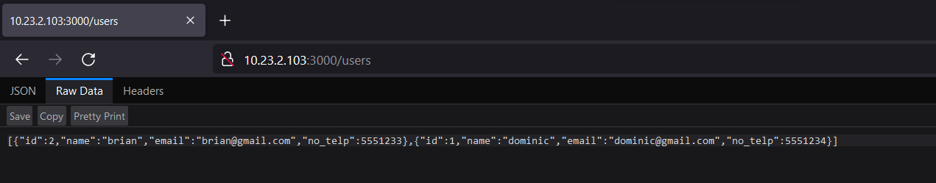

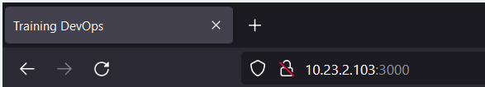
Image
Docker
Kemudian kita coba ubah pathnya ke /users. Jika berhasil akan menampilkan json dalam bentuk raw. Disini karena saya menggunakan browser firefox jadi bisa ditampilkan dalam bentu raw dan json.
Pengujian
Setelah semua konfigurasi dilakukan, sekarang kita akan jalankan docker composenya. Gunakan perintah dibawah untuk menjalankan docker compose.#docker-compose build #docker-compose up -d
Sekarang kita lihat apakah containernya sudah jalan atau belum.#docker ps atau #docker-compose ps
Sekarang kita buka web browser dan lihat apakah simple appsnya sudah jalan atau belum.
root@panda: /deploy/simple-apps# docker ps
root@panda: /deploy/simple-apps#
Notes:
https://www.idn.id/docker-pada-ubuntu-20-04/

Slide 28
Docker Containers For Deep Learning
Notes:
https://docs.nvidia.com/deeplearning/frameworks/user-guide/index.html

Slide 29

Image
Docker
Instalasi
Lakukan update pada server dan instal package docker.io.$sudo apt update -y && sudo apt install docker.io
Instal juga package virtual environment python3 untuk uji coba menjalankan aplikasi webnya.$sudo apt install python3.8-venv -y
p
OpenMAP-T1
OpenMAP-T1: A Rapid Deep-Learning Approach to Parcellate 280 Anatomical Regions to Cover the Whole Brain
Author: Kei Nishimaki, Kengo Onda, Kumpei Ikuta, Jill Chotiyanonta, Yuto Uchida, Susumu Mori, Hitoshi Iyatomi, Kenichi Oishi
Notes:
https://github.com/OishiLab/OpenMAP-T1

Slide 30
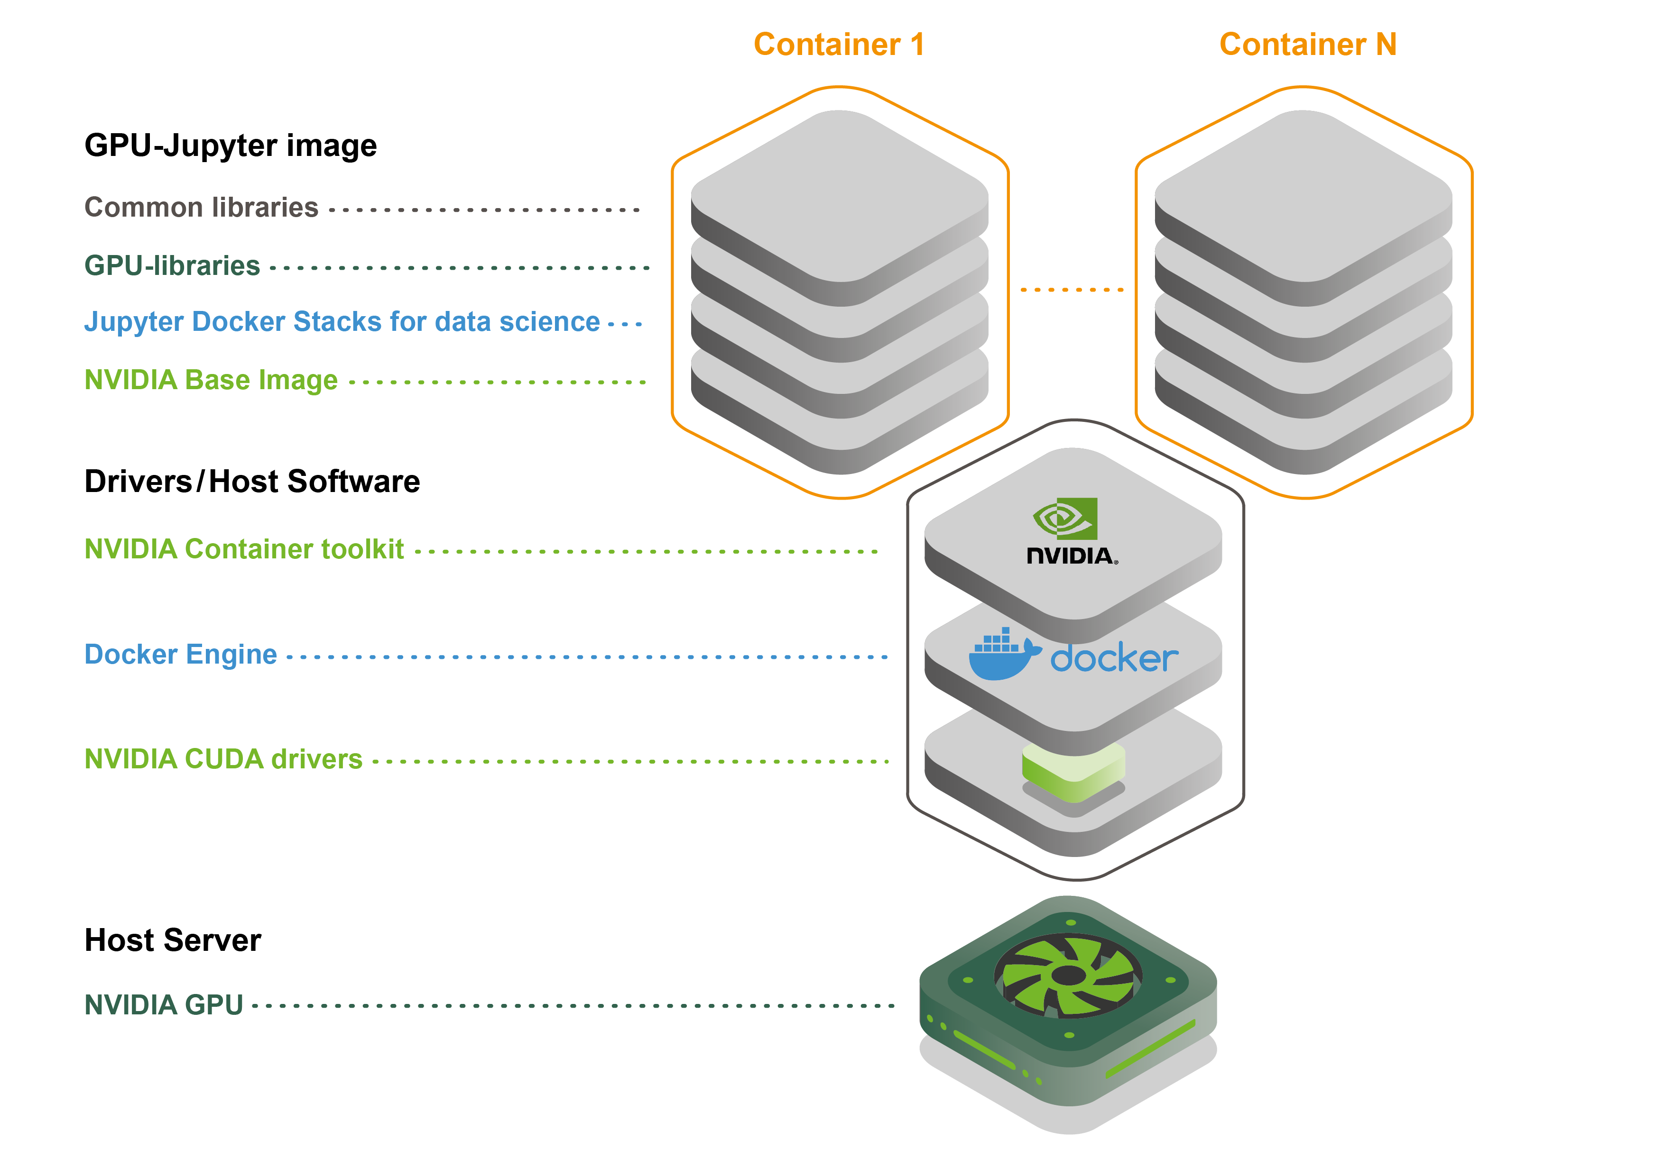
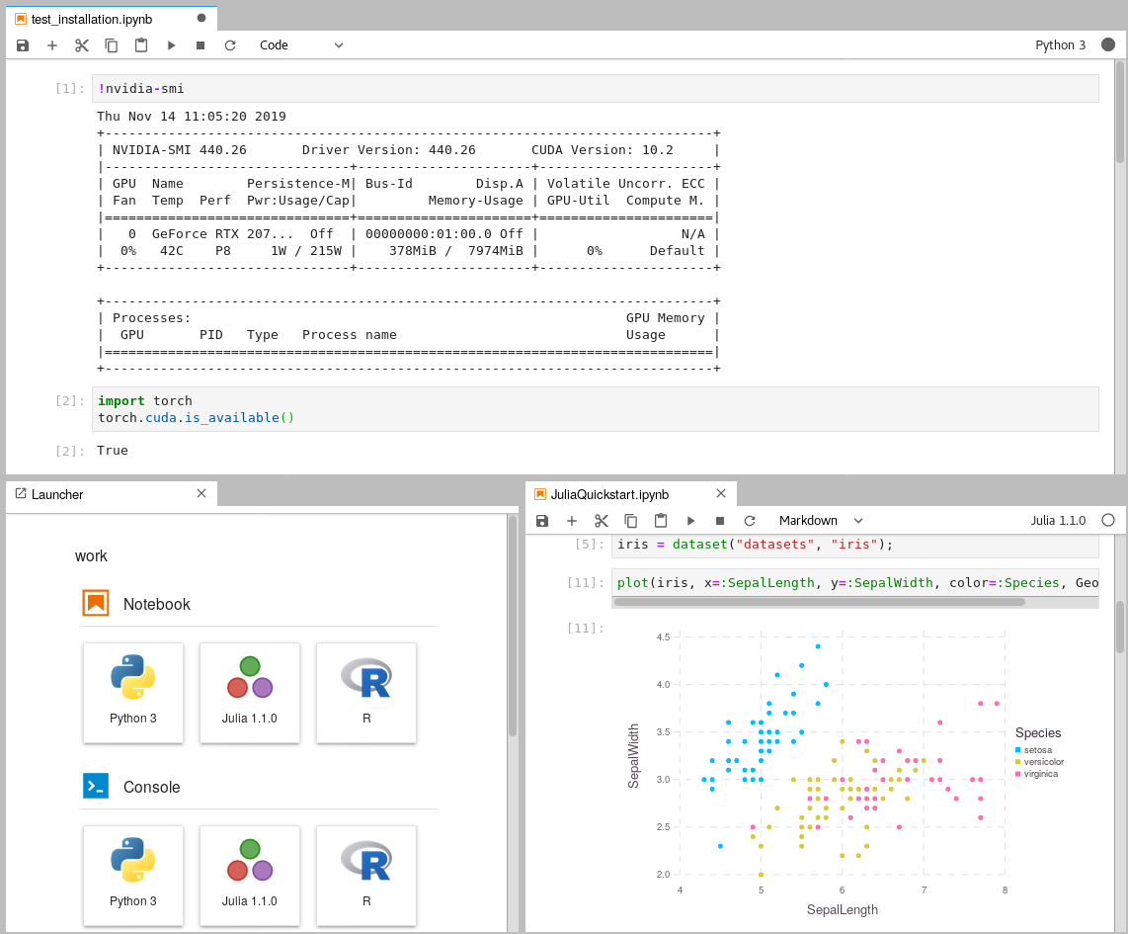
Image
Docker
MultiGPUs-Jupyter
@Kin-Zhang Kin-Zhang mentioned this pull request on Apr 20
https://github.com/lllyasviel/FramePack/pull/106
Multi GPUs in docker nvidia container #135
https://github.com/mmartial/ComfyUI-Nvidia-Docker
https://hub.docker.com/r/cschranz/gpu-jupyter
Notes:
https://hub.docker.com/r/cschranz/gpu-jupyter
https://github.com/iot-salzburg/reproducible-research-with-gpu-jupyter
https://docs.nvidia.com/datacenter/cloud-native/container-toolkit/latest/install-guide.html
https://github.com/mmartial/ComfyUI-Nvidia-Docker

Slide 31
THX

